Slide 1
Git It Together: “An Introduction to Version Control for Revit Users”
John Pierson
Design Technology Specialist
Parallax Team

Slide 2
git it together
“VERSION CONTROL FOR BEGINNERS”

Slide 3
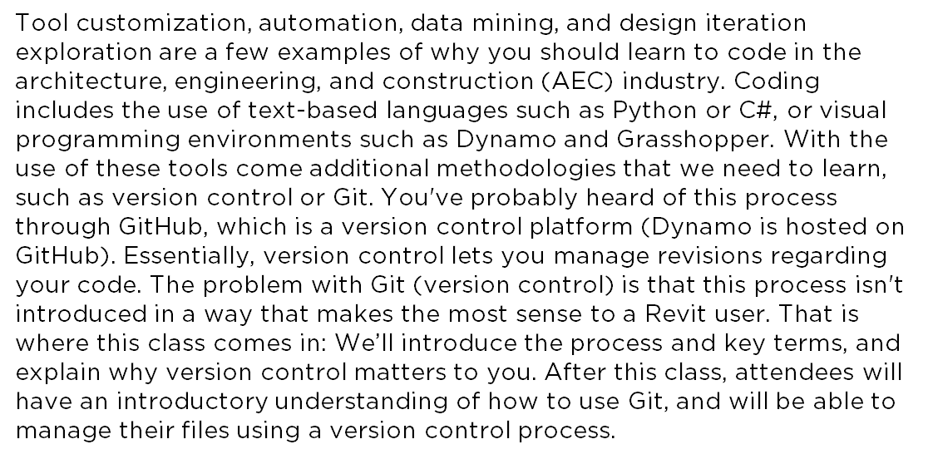
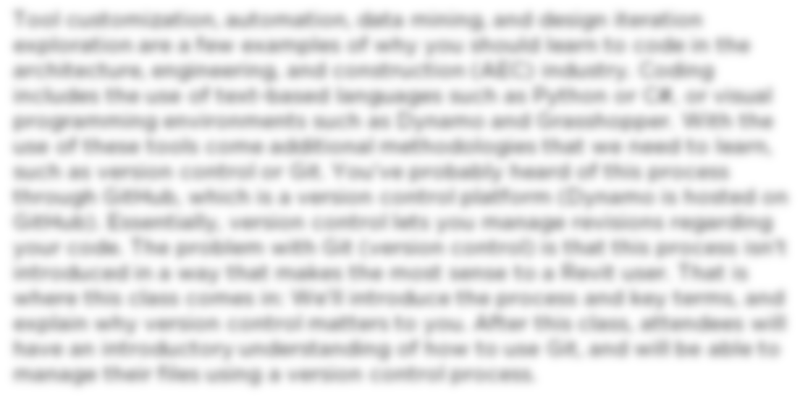
Summary
Essentially, version control lets you manage revisions regarding
your code.
We’ll introduce the process and key terms, and
explain why version control matters to you.

Slide 4
Learning Objectives
Gain an introductory understanding of version control processes.
Understand key Git terms.
Learn how to manage your files using version control.
Learn how to actively contribute to open-source projects.

Slide 5

About the Speaker
John Pierson
Design Technology Specialist at Parallax Team
Reviteer since 2012
Dynamo User since 2014
Dynamo Package Developer since 2015, (Rhythm, Bang!, DuctTape, Monocle).
BILTNA Top Rated Speaker
Revit Certified Professional for Architectural, Structural, MEP

Slide 6


The Core Team
Parallax Team is a Practice Implementation Consultancy specializing in implementation, computational design, and pretty much anything AEC related.
www.parallaxteam.com | @prlxteam
Aaron Maller
Director
@twiceroadsfool
John Pierson
Design Technology Specialist
@60secondrevit

Slide 7

Who are you?

Slide 8
What is Git?
A Version Control Software – Meaning that it manages changes to a project without overwriting any part of that project.
Created in 2005 by Linus Torvalds (linux dude)
Essentially prevents user’s writing over each other’s files, or my personal favorite, you screwing up your code and saving over the working code.

Slide 9
Git is awesome because
All versions are saved via a “snapshot”
You can merge changes and review the differences of the same file that has been modified.
Less losing work = more time for better things.

Slide 10
Why do we need to know this?

Slide 11
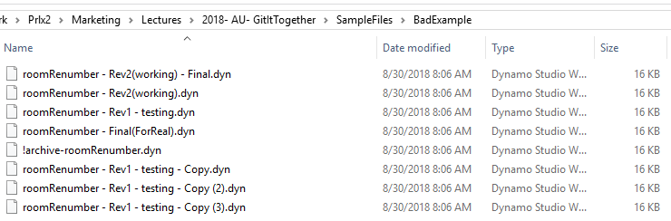
Why do we need to know this?
Sometimes we suck at managing files.

Slide 12
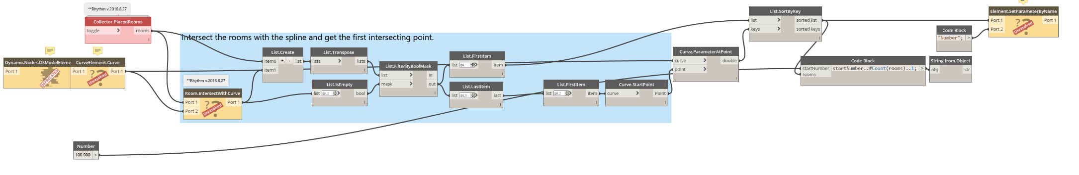
Why do we need to know this?
We’ve all had the “But it worked yesterday” experience.

Slide 13
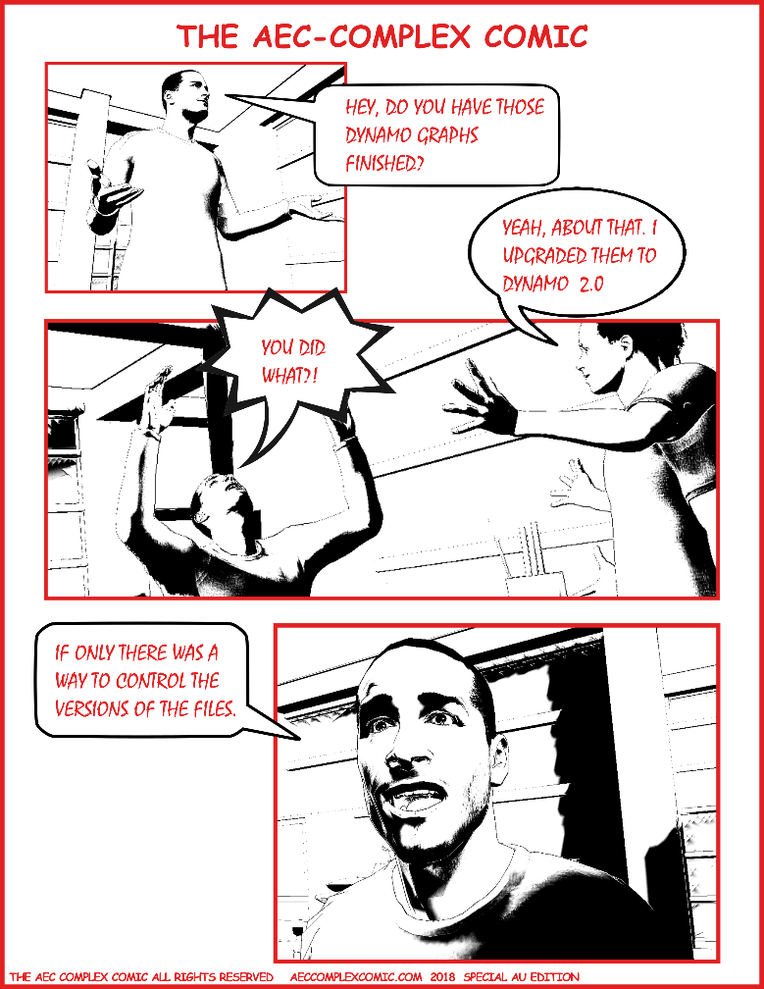
Why do we need to know this?
We have all ran into that one user that “does what they want”.

Slide 14



Why don’t we all know how to use this?
command line (primarily)
you don’t know what you don’t know
not the most intuitive thing with new terms and processes

Slide 15
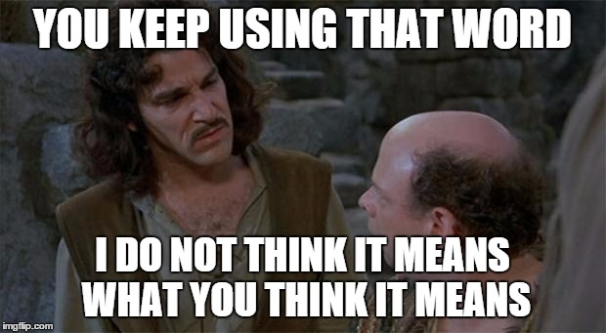
Key Terminology

Slide 16
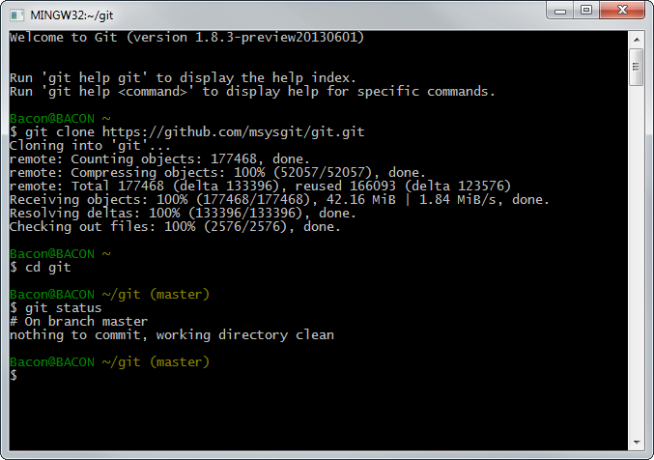
Key Terminology Command Line
Interface for text-based input for Git. (not how we are going to be doing this today)
https://gitforwindows.org/

Slide 17
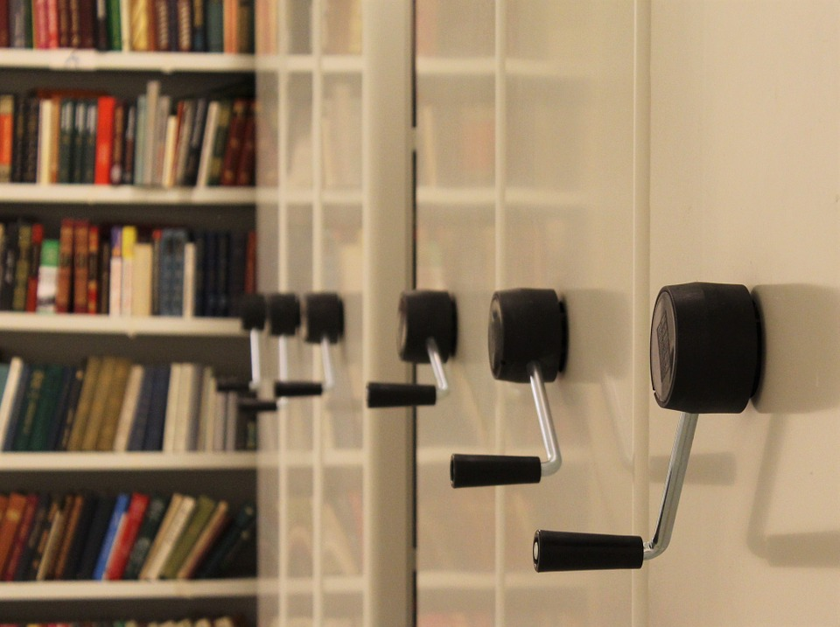
Key Terminology Repository/Repo
Storage space where your projects live. (similar to a Revit central file)

Slide 18
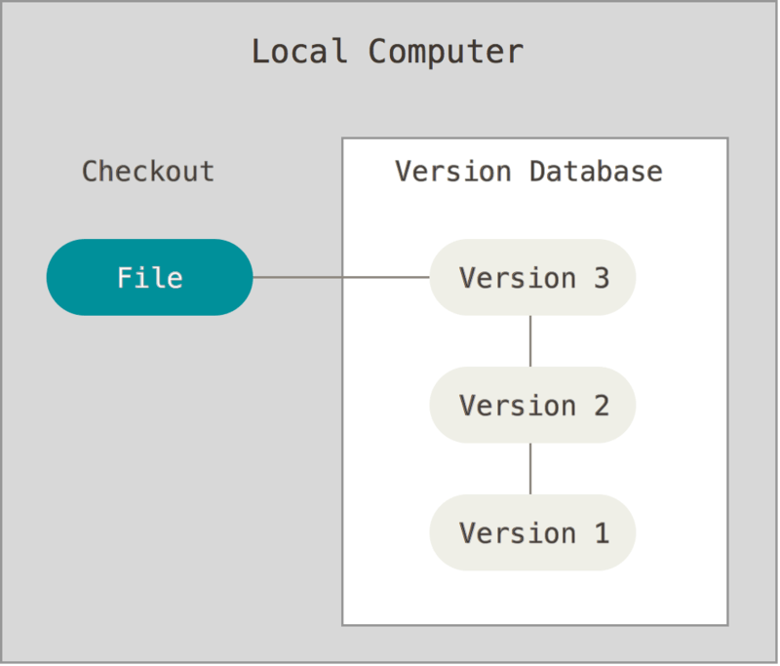
Key Terminology Version Control
Instead of manually saving multiple versions, Git saves “snapshots” of every point in time for the life of the project. (similar to Revit’s backup folder, but better.)

Slide 19

Key Terminology Commit
This is the beautiful part. A commit is you pushing your changes to Git. Each time you commit to the repo, Git takes a snapshot to give you a checkpoint to go back to if needed. (similar to a sync with central, but also way better)
Sending your changes off to the repo!

Slide 20
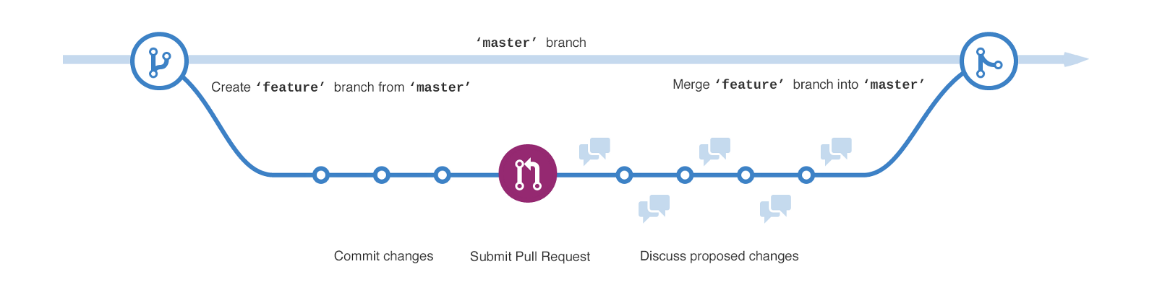
Key Terminology Branch
This allows people to work on their own version of the project before pushing the changes back to the main project. (similar to a Revit local file)

Slide 21
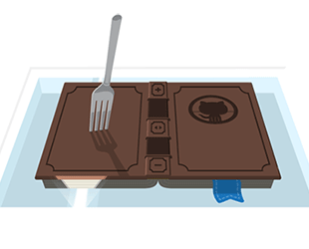
Key Terminology Fork
Your very own copy of a project separate from the source project with the option to push your changes to the source if you want to.

Slide 22
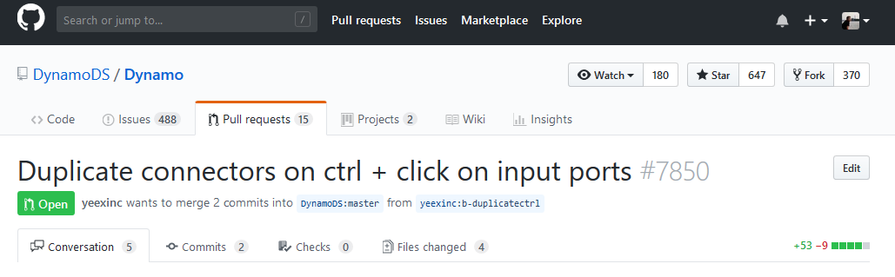
Key Terminology Pull Request
A way of submitting contributions to an open project. This is done by making changes on your fork and generating the pull request (PR).

Slide 23
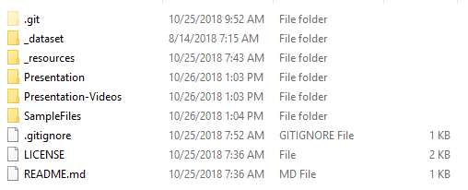
Key Terminology .gitignore
When you are managing a project with version control, there are definitely going to be files you don’t want to “sync” to the repo. Rather than removing these files from the local repo we can tell github to ignore them by extension!

Slide 24
This AU Class was… built using Github

Slide 25
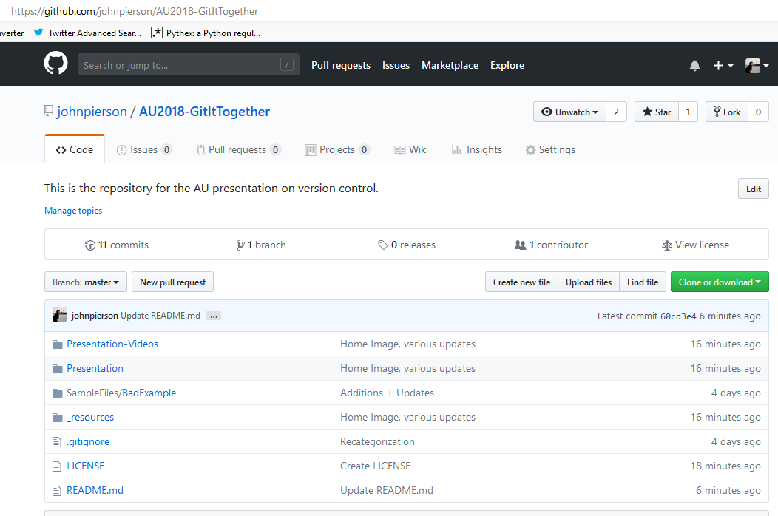
This AU Class was… built using Github
The landing page with all the data

Slide 26
Resources
Markdown
https://guides.github.com/features/mastering-markdown/
https://github.com/adam-p/markdown-here/wiki/Markdown-Cheatsheet
Misc
This exact presentation’s repo. https://github.com/johnpierson/AU2018-GitItTogether
https://guides.github.com/activities/hello-world/
License
Choose a license https://choosealicense.com/
Creative Commons https://creativecommons.org/

Slide 27
Now, Let’s Build Some Workflows. (and use version control)
Start a Github Project
Establish ReadMe and .gitignore
Choose a license
Build cool stuff and manage it.
Collaborate: AKA Have other users mess with it.

Slide 28



Workflows to Choose From
Read Family Category without Revit
Load View Templates from File
Modify Your (or your coworker’s) Revit Ribbon

Slide 29
thank you.
NOW, GO DO AWESOME THINGS
@prlxteam | @twiceroadsfool | @60secondrevit

Slide 30

Creating a Repo

Slide 31
Cloaning a Repo Locally

Slide 32
Uploading Files

Slide 33
Autodesk and the Autodesk logo are registered trademarks or trademarks of Autodesk, Inc., and/or its subsidiaries and/or affiliates in the USA and/or other countries. All other brand names, product names, or trademarks belong to their respective holders. Autodesk reserves the right to alter product and services offerings, and specifications and pricing at any time without notice, and is not responsible for typographical or graphical errors that may appear in this document.
© 2018 Autodesk. All rights reserved.

